Slide 1
National Parks Builder - Group 2
Prepared by: Maaz Ahmed, Bryan Gutierrez, Ammar Idrees, Zaid Patel

Slide 2
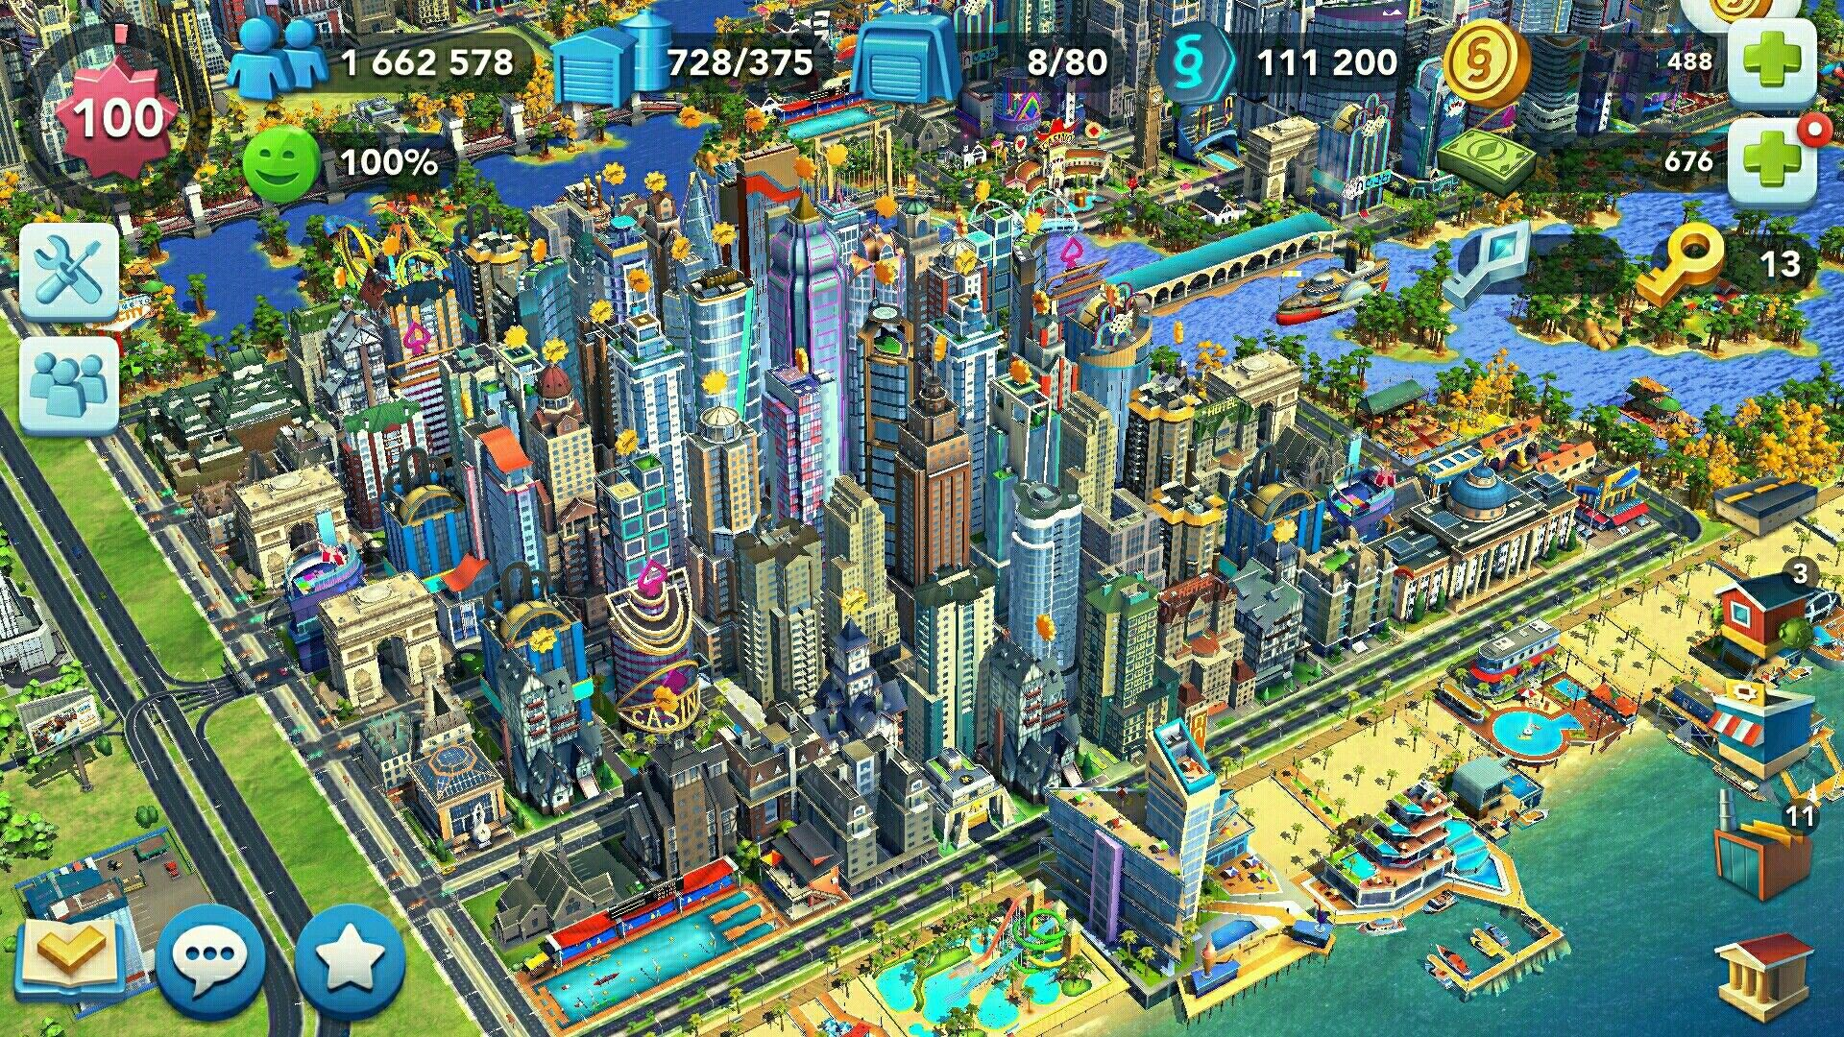
Project Description
Gaming Application
Build a National Park from scratch
Learn the in and outs of how to manage and maintain a National Park
Entertainment value

Slide 3

User Background
Our main client focus is the National Parks Foundation
Purpose: Entertaining & informative
Increase attendance
Rise of electronics in today’s society and how to and how to encourage more visitors
Create respectfulness in working environment

Slide 4
Measurement
Goals of Project
Increase number of visitors for National Parks
Increase profit
Better employee moralee
Less incidents
Track monthly averages
Surveys
Revenue
In 2018, the National Park Service received over 318 million recreation visits; down 12.67 million visits (3.8%) from 2017

Slide 5
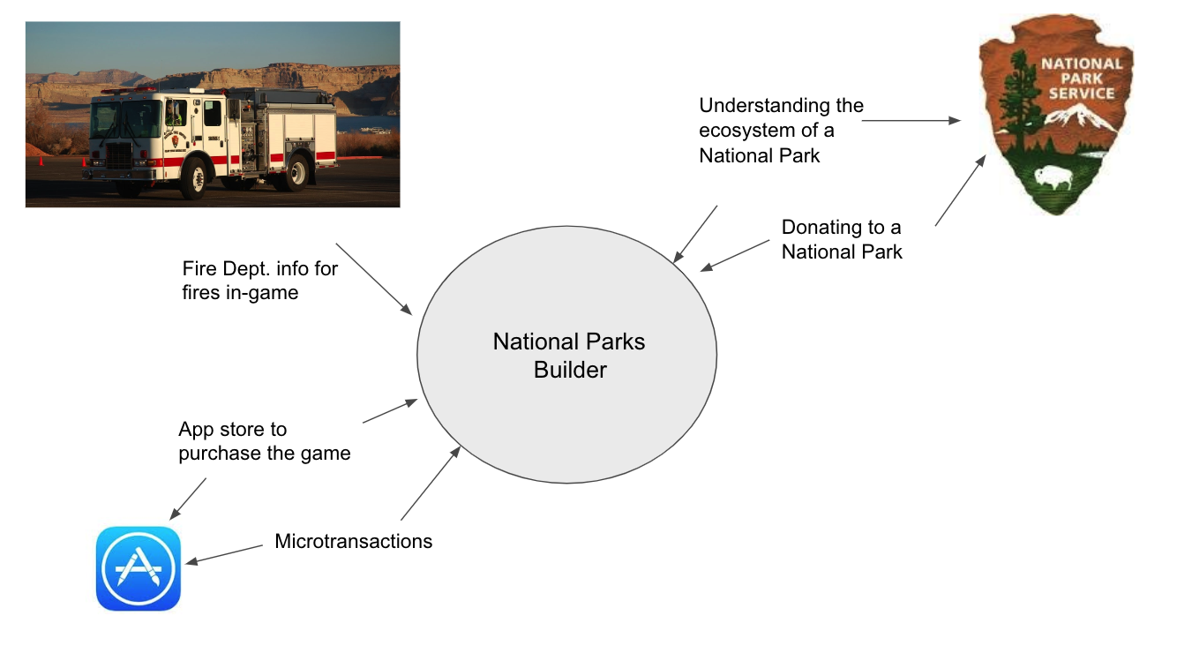
Scope of the Work
Another form of awareness
Context of the Work
National Park Service
App Stores
Fire department
Work partitioning
Donations
Competing Products

Slide 6
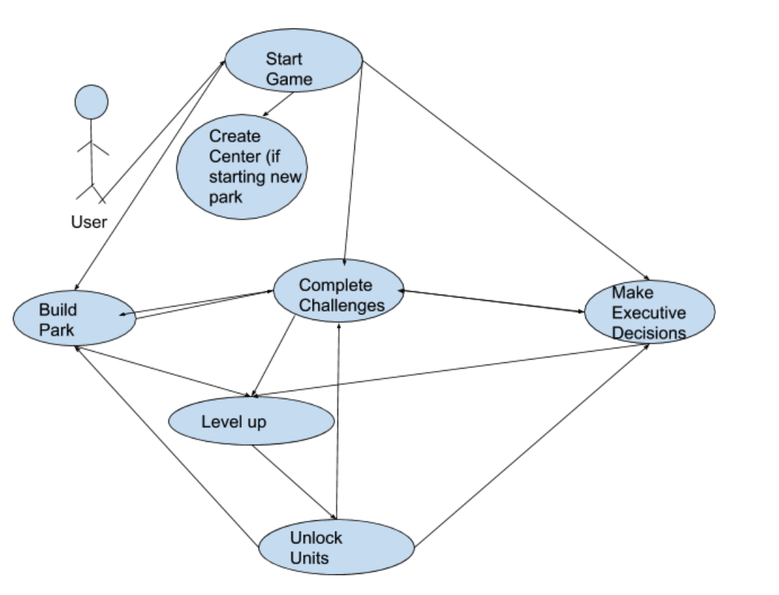
Scope of the Work
Main Purpose of the National Park Builder
Build Park
Scenario List
User adds natural units
User adds Building Unit
Fire
Cleaning area
Microtransactions

Slide 7
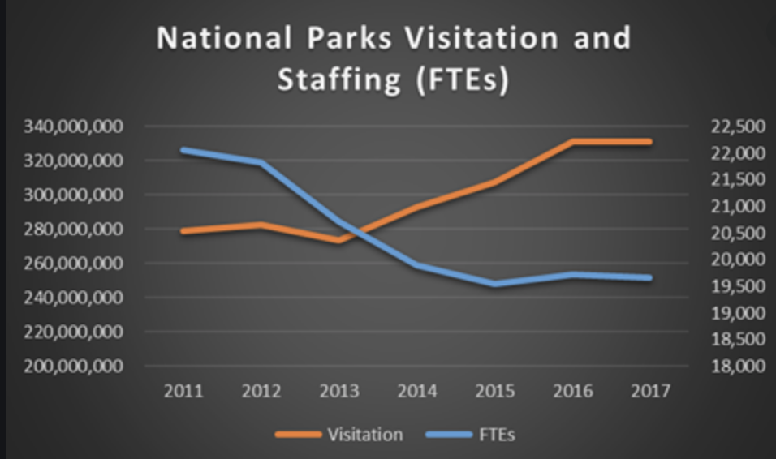
The Beneficiaries and Users
The land of National Parks are owned by private investors, and would present to be as stakeholders for the National Parks
For example Yellowstone National Park has a yearly budget of 34 million dollars,
Other Possible Stakeholders:
Strategic Analysts
Software Developers/Quality Testers
Marketers

Slide 8
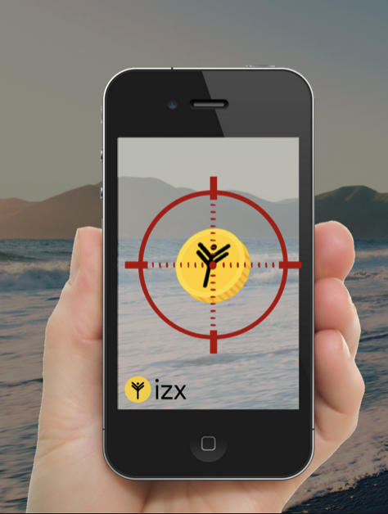
Premium Feature
-Goal is to get customers to travel to National Parks to get familiarized with the areas.
- Using Computer Vision/ Augmented Reality customers will travel through the parks searching for tokens which can be converted to game currency.
-Will encourage larger traffic throughout National Parks, while bringing in larger amounts of awareness

Slide 9
Running the Applications/Off-Shelf Software
-The application should be able to work on all mobile platforms so Xamarin or Flutter could be the solution to build the UI, and could be combined with Java.
- Application will feature a giant map of the National Park consisting of different sectors of the park such as Forestry, water reservoirs, wildlife.
-There will be a health bar that will control all features of the map, using event listeners

Slide 10
Naming Conventions and Definitions
Definitions
Park - Area user will build on.
Center - Main hub of park
Land - Unused space
Unit - Some sort of object, building, or piece of nature.
Models
User - Should require a server. Should be able to view things such as currency, morale, and average visits
Currency - Integer that is at a minimum of 0.
Morale - Integer value with range from 0 to 100. Would be visualized as a meter.
Average visits - would contain total number of visits and age of park. Will display double value by dividing the total visits with the age.

Slide 11
Relevant Facts and Assumptions
Research on National Parks
Will be used as “fun facts” that can be displayed to the user to give awareness.
Data can be used to create realistic challenges for the user.
Can mimic real life challenges that national parks face.
Assumptions
User should be able to perform basic tasks:
Navigate Menu
Play game
User should have the necessary hardware requirements to run game.

